Slide 1
Android sweat shop
first meeting 23.6

Slide 2

Me -
Serj Smorodinsky
M.S.c Bioinformatics
3 Years of Android development
Moto: practice first theory second
Serjsmor@gmail.com
Github: https://github.com/serjSmor
Blog: https://serjdroid.wordpress.com

Slide 3
Sweat shop info
I count that you are familiar with some OOP language
Emphasis on coding first
Project oriented - we are learning in order to accomplish a task
Projects and slides will be available on Github
It’s a headstart, and not a complete Android course

Slide 4
Table of contents
Why Android
What is Android
HelloWorld
Activity
Lifecycle
Logcat
Assignment
Views
Layouts
Attributes
Assignment
Buttons
OnClickListener
Toast
Assignment
Summary

Slide 5
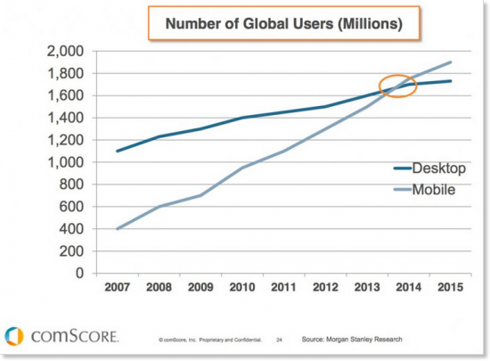
(Why)
Desktop to mobile

Slide 6
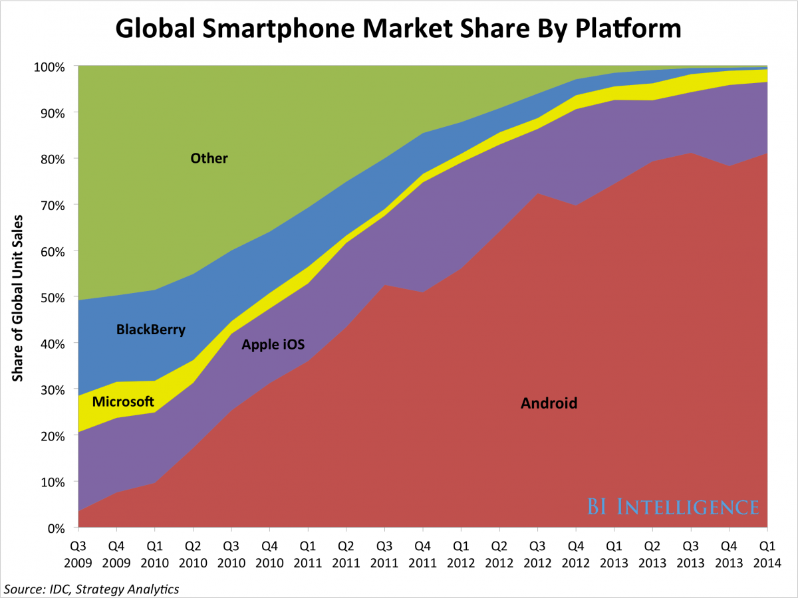
From iOS to Android

Slide 7
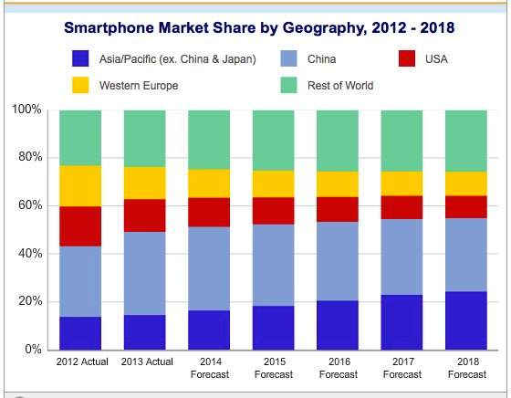
West to east

Slide 8

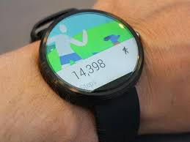
Future of platform

Slide 9
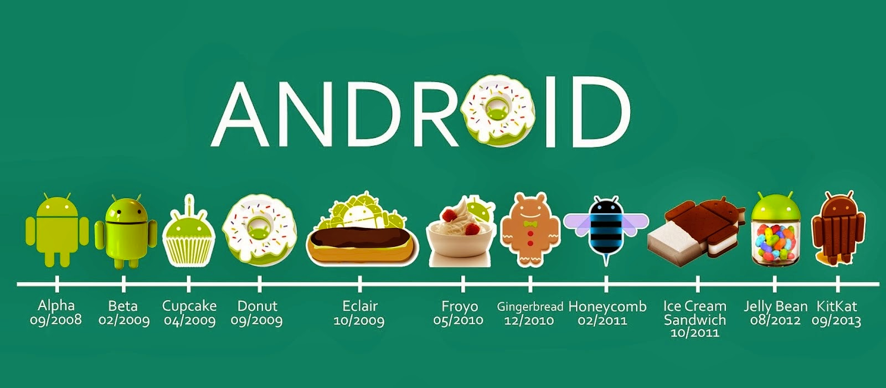
Trivia
From: https://lokeshv.wordpress.com/tag/android/

Slide 10
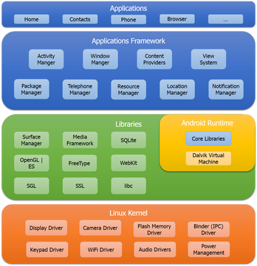
(What)
Android architecture
From: https://lokeshv.wordpress.com/tag/android/

Slide 11
(What)
The Android stack is basically a linux kernel
Android has NDK - allows combining C++ code
Lots of interprocess communication - Binder. Example - GPS service

Slide 12
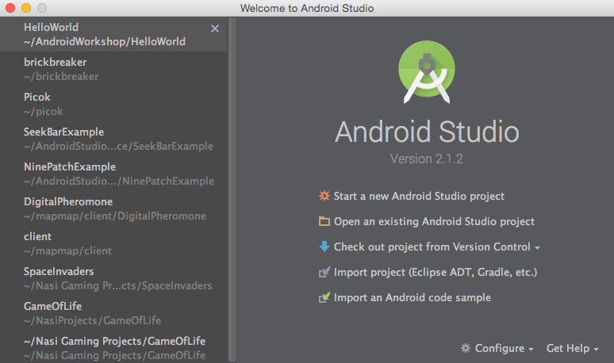
HelloWorld -
create new project

Slide 13
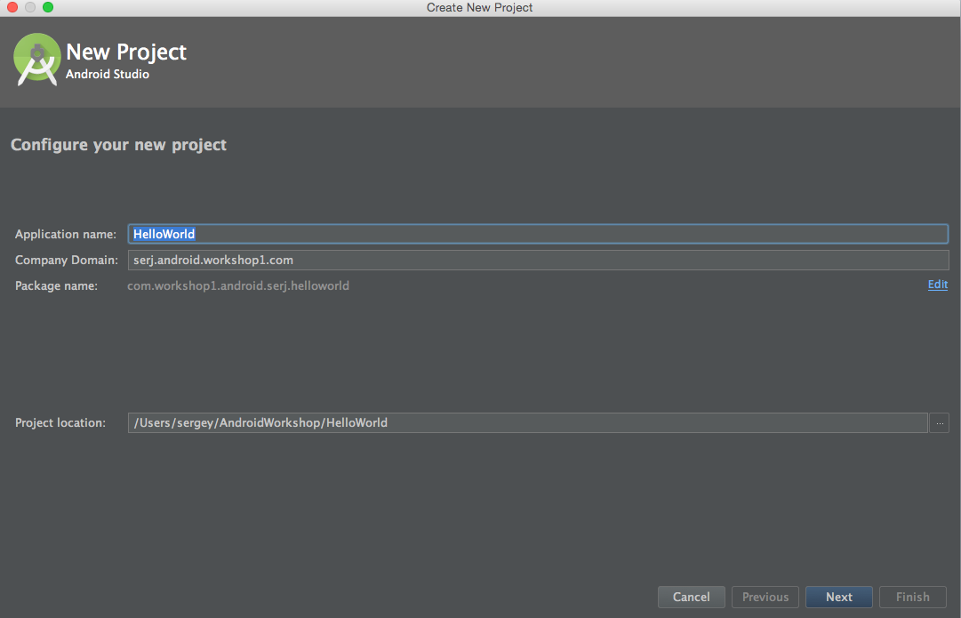
HelloWorld -
name it

Slide 14
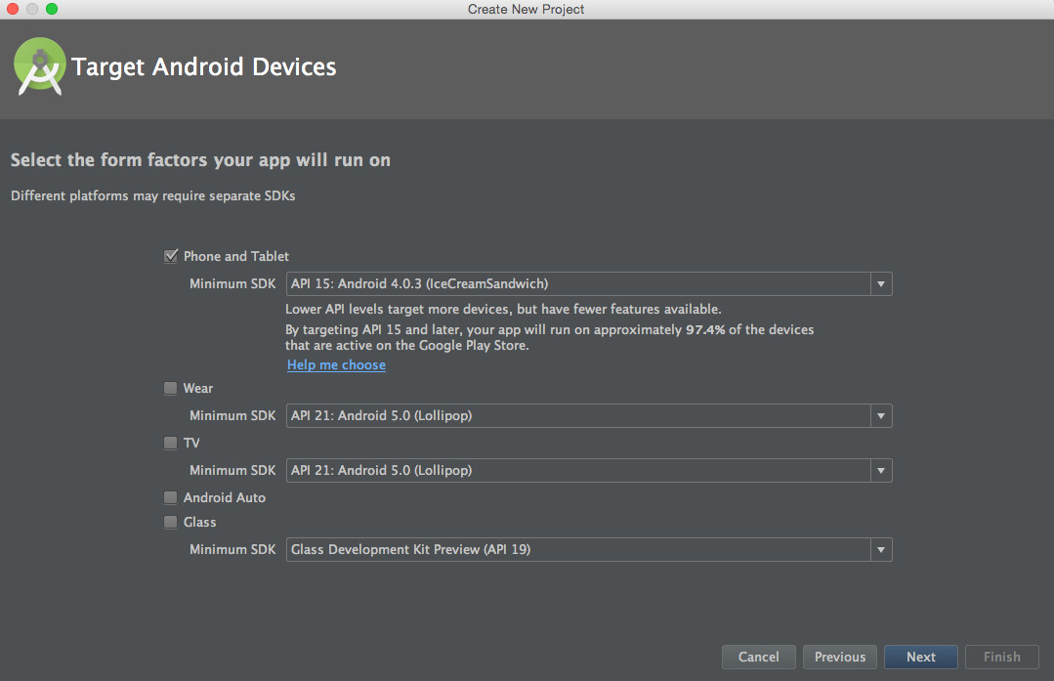
HelloWorld -
targets

Slide 15
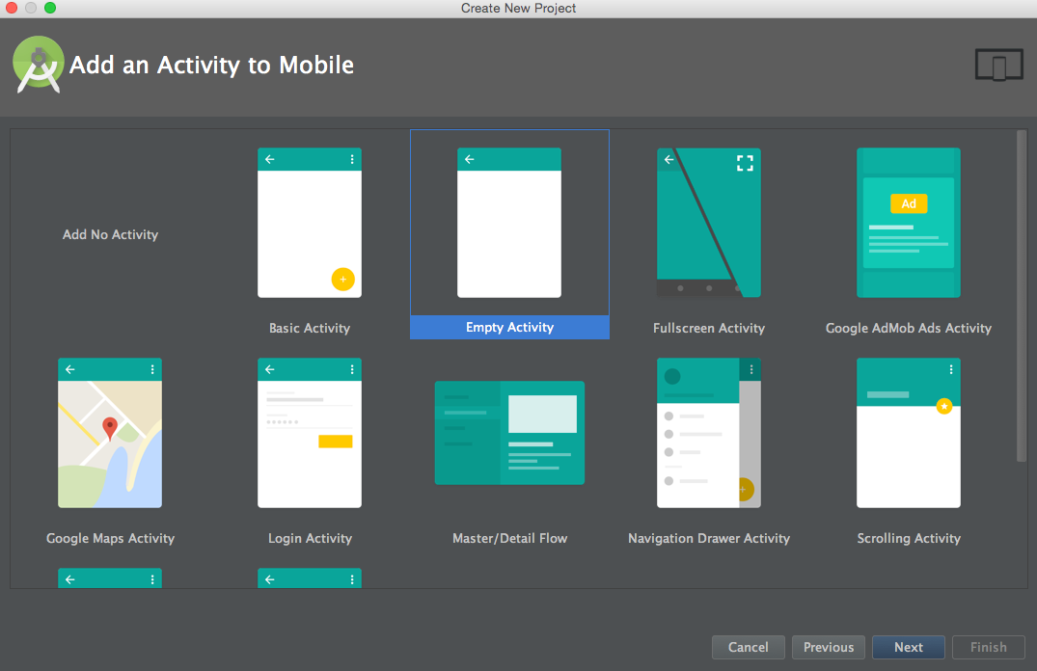
HelloWorld -
templates

Slide 16
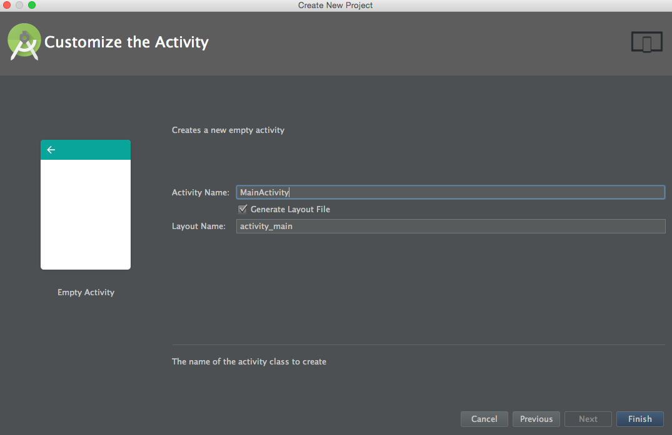
HelloWorld -
name activity

Slide 17
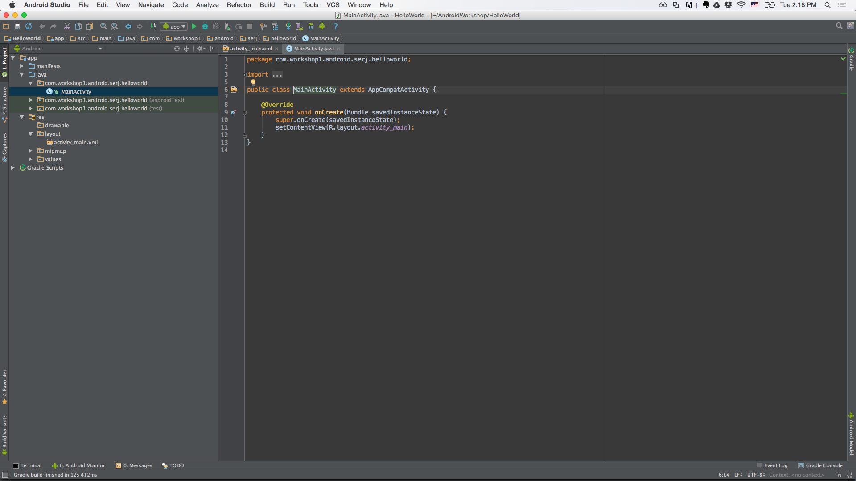
HelloWorld -
MainActivity

Slide 18
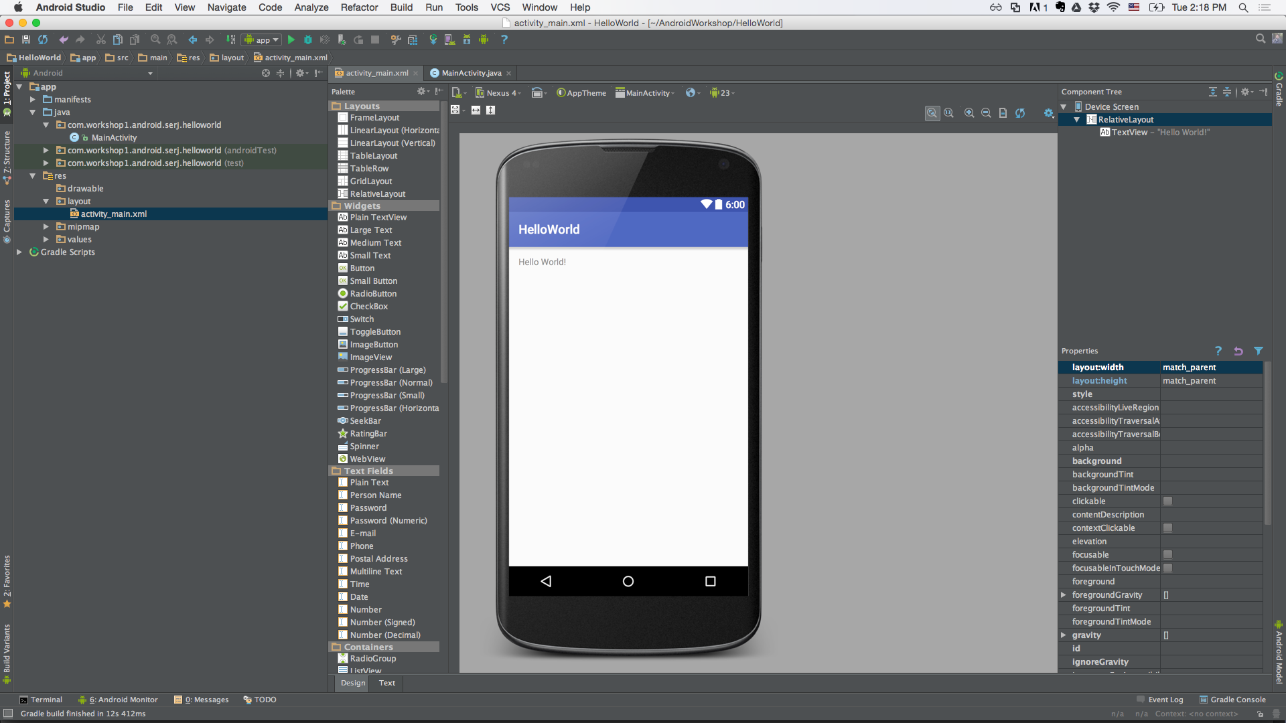
HelloWorld -
activity_main preview

Slide 19
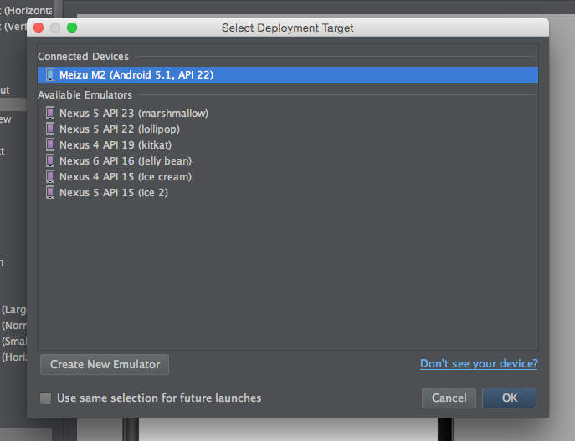
HelloWorld -
run configuration

Slide 20
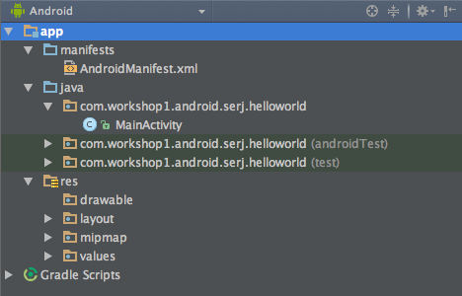
HelloWorld -
Project structure

Slide 21
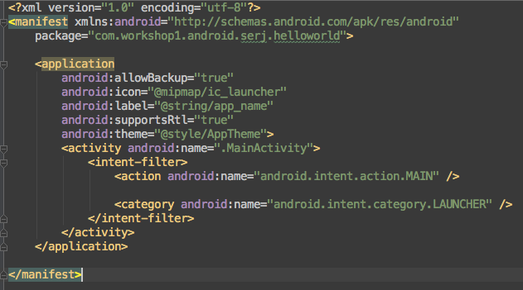
HelloWorld -
AndroidManifest.xml

Slide 22
Activity is the
Single window (mostly full screen)
You place your view in setContentView(View)
MVC - Activity is the controller
It has lifecycle methods
1/4 of the basic components of Android apps

Slide 23
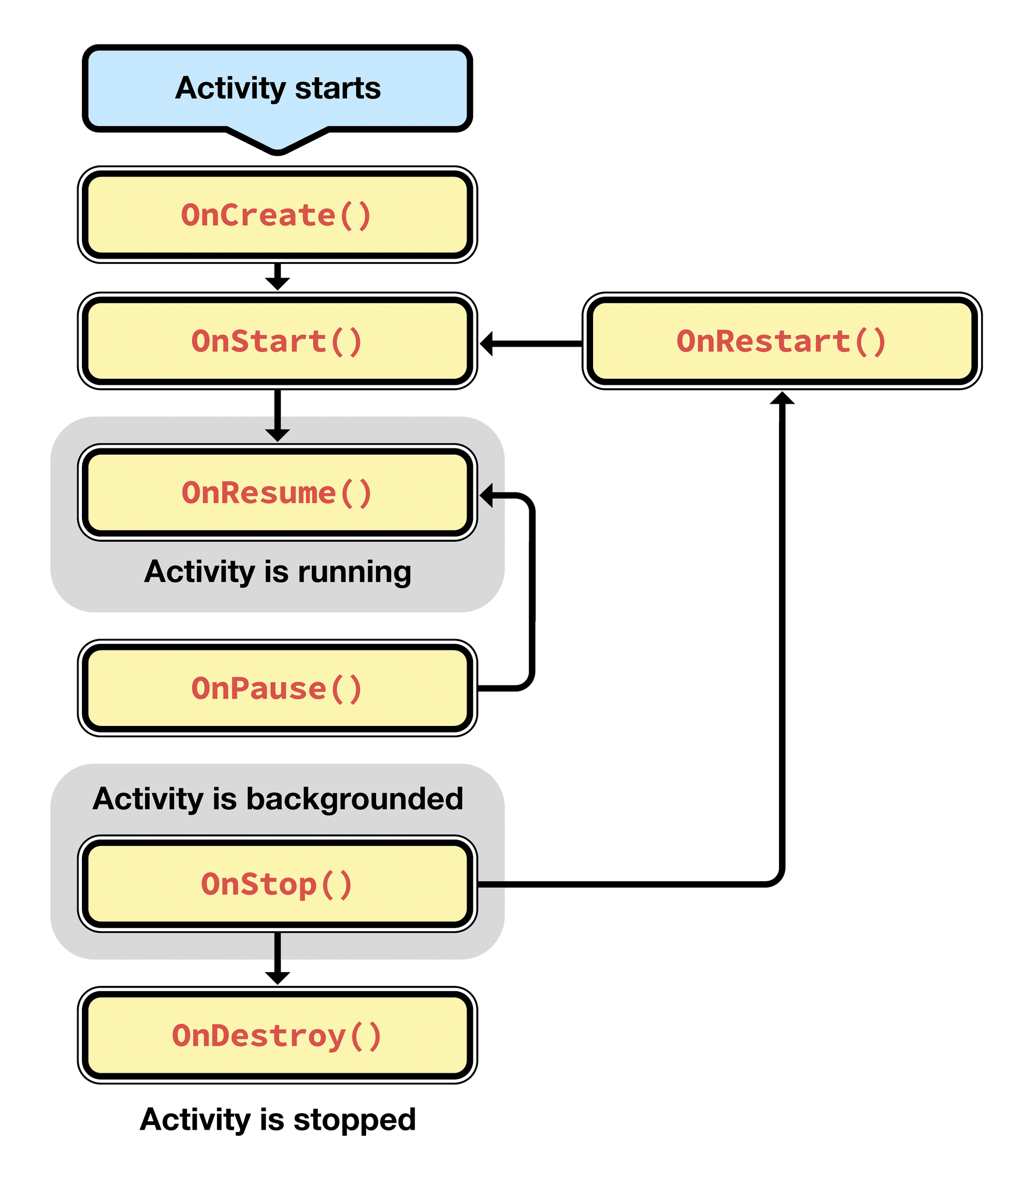
Activity life cycle (state machine)
from: developer.xamarin.com

Slide 24
We will implement a couple
from: developer.xamarin.com

Slide 25

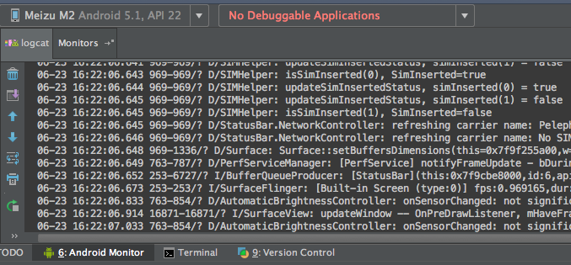
Logcat
is our friend
from: elektronengehirn.blogspot.com

Slide 26
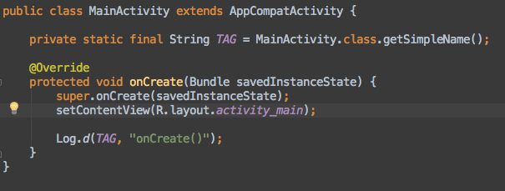
Logcat
is our friend
We will use Log.d
There are 5 more(v, i, w, e, wtf)
TAG string
from: elektronengehirn.blogspot.com

Slide 27
First assignment
Print debug messages from life cycle methods:
onCreate()
onResume()
onPause()
onDestroy()

Slide 28
Questions
How’s the life cycle is different from a C,C++,Java program ?
What are the unique challenges of mobile ?

Slide 29
Answers
Q: How’s the life cycle is different from a C,C++,Java program ?
A: C,C++ etc programs have a single entry point - static void main(), vs Android multi entry point
Q: What are the unique challenges of mobile ?
A: Multi task - switching applications constantly. Like a phone call.
A: Low on resources, things can get destroyed on demand

Slide 30
Bonus question
Q: If we would print the lifecycle messages on screen, which ones we will see ?

Slide 31
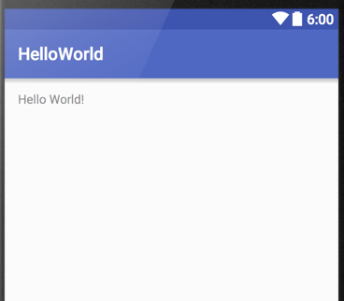
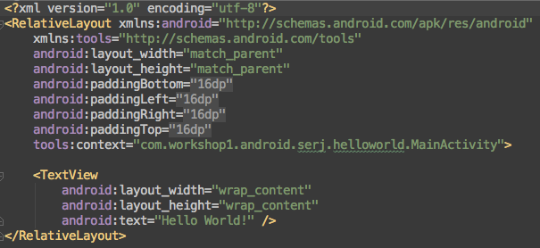
Views -
activity_main.xml
Outcome
XML
*layouts conventions. activity_..

Slide 32
Views -
activity_main.xml
XML
Parent
Children
*layouts conventions. activity_..

Slide 33
Layouts
Layouts describe how their children will be ordered.
RelativeLayout - children location are relative to one another. (Not the best parenting)
LinearLayout - one after another

Slide 34
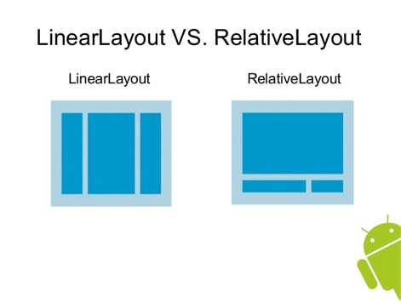
Layouts example
From: http://www.slideshare.net/vivekbhusal/android-training-day-2

Slide 35
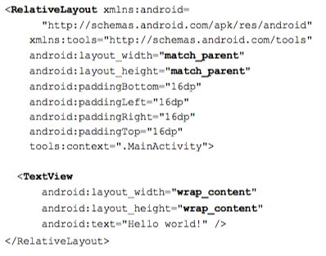
Important attributes
Size of layout:
layout_width
layout_height

Slide 36
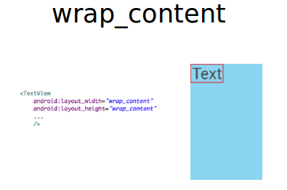
wrap_content
From: http://www.vogella.com/tutorials/Android/article.html

Slide 37
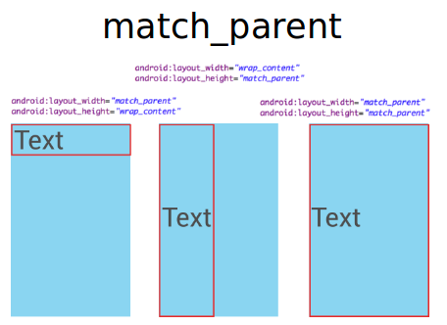
match_parent
From: http://www.vogella.com/tutorials/Android/article.html

Slide 38
layout_width,
layout_height
Can be also constant size.
layout_width = “15dp”
layout_height = “20dp”

Slide 39
Java vs XML
Java is a multi paradigm language: Object oriented, procedural and more. It describes how things are done.
XML is declarative. It describes how things look.
All of the things we can do with XML, are also Java compatible.

Slide 40
Third assignment -
activity_main.xml
Add another TextView - dragging for the design screen
Add another TextView - coding by hand
Switch the RelativeLayout to LinearLayout

Slide 41
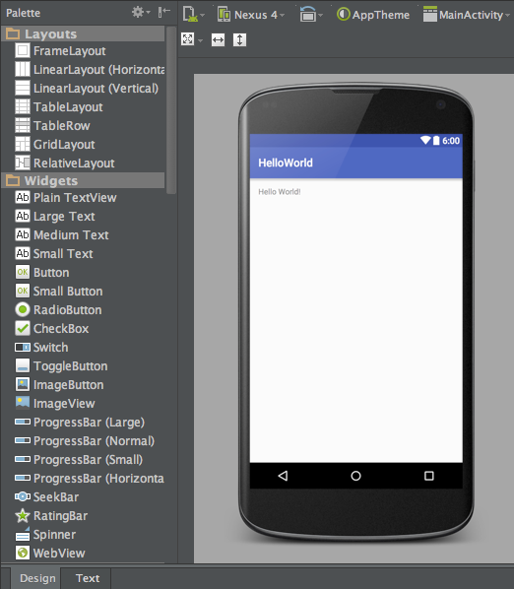
Reminder -
design screen

Slide 42
Android Studio shortcuts -
more to come
cmnd + o - open class
cmnd + f12 - structure + methods
More: http://www.developerphil.com/android-studio-tips-tricks-moving-around/

Slide 43
Start second assignment

Slide 44
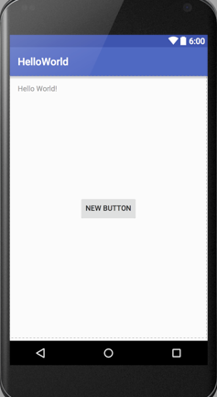
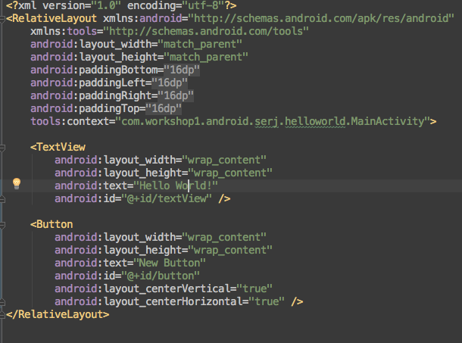
Buttons

Slide 45
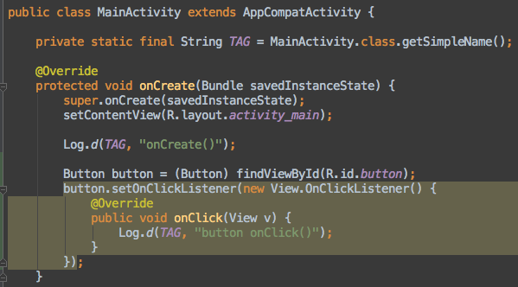
OnClickListener

Slide 46
OnClickListener
Button button = (Button) findViewById(R.id.button); button.setOnClickListener(new View.OnClickListener() { @Override public void onClick(View v) { Log.d(TAG, "button onClick()"); } });

Slide 47
OnClickListener
Does what it says
It’s an Anonymus Class
Similar to Java Swing - GUI programming - left the procedural realm

Slide 48
Message to screen -
Toast
Toast.makeText(MainActivity.this, "button onClick()", Toast.LENGTH_SHORT).show();

Slide 49
Third assignment -
A click counter
Add a counter variable
Show it using the TextView
Manipulate the counter after a button click
Set the new result

Slide 50
R class
Is generated for us
Lots of constants we can use

Slide 51
findViewById(R.id.view)
Does what it says
It’s a method we inherit from Activity
Can only find what’s in our layout (setContentView)

Slide 52
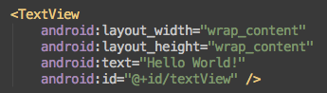
Important attribute -
id
That’s how we find our views programmatically.

Slide 53
Start third assignment

Slide 54
Summary
Android is kewl and China is gonna rule around 2018
Creating a project
Activity is the
Logcat is console like
Views - layouts are parents, views are children (layouts can be children too)
Button OnClickListener

Slide 55
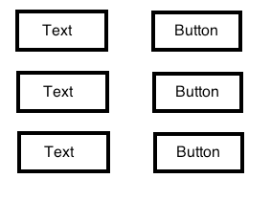
Home work
A client asked for a grid like app, each TextView should hold a separate counter
Bonus - use three horizontal LinearLayout for each row, and a vertical LinearLayout for their parent

Slide 56
Next time
Goal - TODO app

